Slide 1
Heterogeneous Swarming
Update

Slide 2
Project Outline
Aim: to create swarming formations of BOLT and RVR robots
Implementation: Creating swarm and initialising BOLT robots as part of same swarm and controlling them through RVR bluetooth
Current Goals:
Test running swarming code onboard RVRs
Modify swarming code so that BOLT robots act alike to RVR robots within swarm

Slide 3
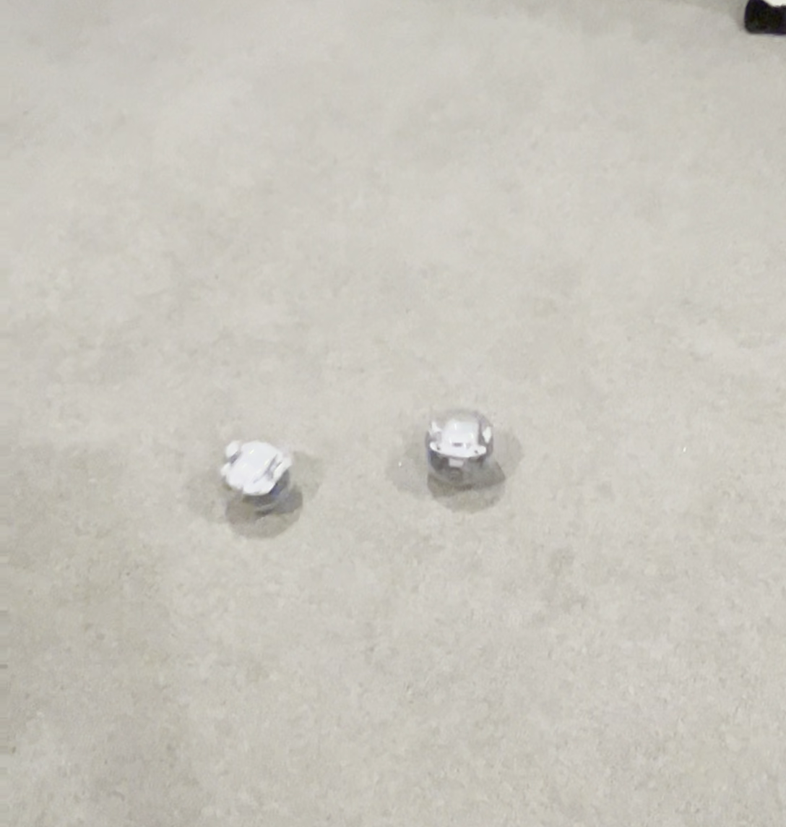
Running Swarming Code off Laptop

